Slide 1
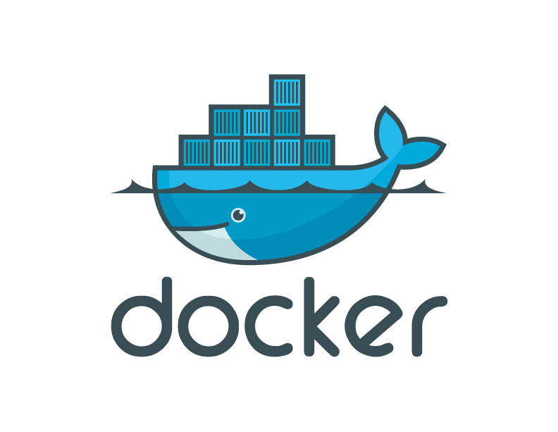
Docker fundamentals

Slide 2
Agenda
Virtualization Overview
Introduction to Containers
Introduction to Docker
Installing Docker
The Docker Architecture
The Docker Engine
Creating a Docker container
Building Docker images
Storing and retrieving Docker images from Docker Hub
Building containers from images
Deploying applications with Docker

Slide 3

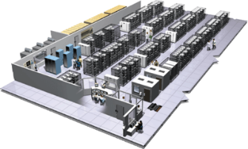
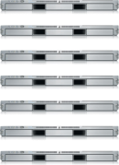
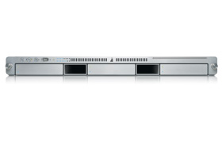
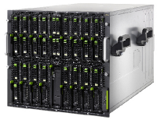

The Challenge
User DB
Static website
postgresql + pgv8 + v8
Queue
Analytics DB
nginx 1.5 + modsecurity + openssl + bootstrap 2
Do services and apps interact appropriately?
Redis + redis-sentinel
hadoop + hive + thrift + OpenJDK
Multiplicity of Stacks
Background workers
Web frontend
Python 3.0 + celery + pyredis + libcurl + ffmpeg + libopencv + nodejs + phantomjs
Ruby + Rails + sass + Unicorn
API endpoint
Python 2.7 + Flask + pyredis + celery + psycopg + postgresql-client
Production Cluster
Development VM
Public Cloud
Multiplicity of hardware environments
QA server
Can I migrate smoothly and quickly?
Disaster recovery
Customer Data Center
Contributor’s laptop
Production Servers
Notes:
Docker מאפשר התקנה אוטומטית של קומפוננטות שונות – בקלות רבה יותר (סביבה נקייה – הכל עובד ☺)

Slide 4
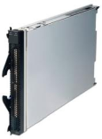
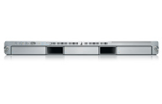
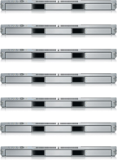

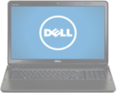
The Matrix From Hell
? | ? | ? | ? | ? | ? | ?
? | ? | ? | ? | ? | ? | ?
? | ? | ? | ? | ? | ? | ?
? | ? | ? | ? | ? | ? | ?
? | ? | ? | ? | ? | ? | ?
? | ? | ? | ? | ? | ? | ?
Static website
Web frontend
Background workers
User DB
Analytics DB
Queue
 | Development VM | QA Server | Single Prod Server | Onsite Cluster | Public Cloud | Contributor’s laptop | Customer Servers

Slide 5
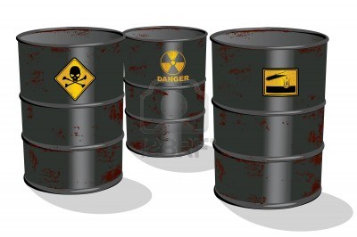
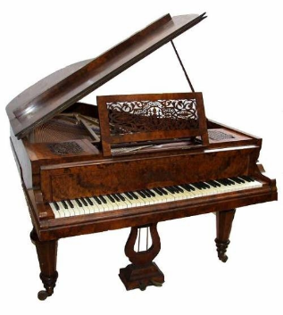

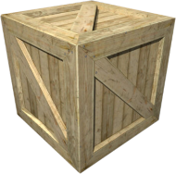
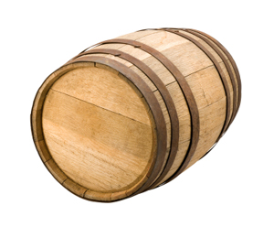
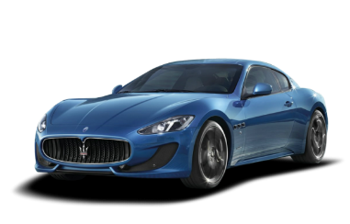
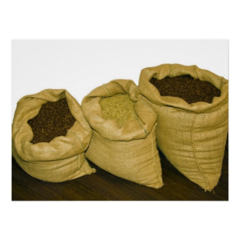



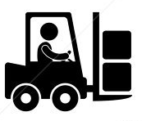
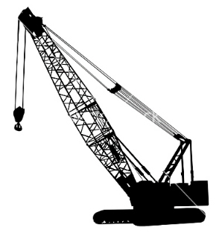
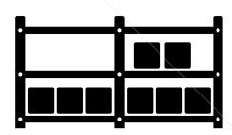

Cargo Transport Pre-1960
Do I worry about how goods interact (e.g. coffee beans next to spices)
Multiplicity of Goods
Multipilicity of methods for transporting/storing
Can I transport quickly and smoothly
(e.g. from boat to train to truck)

Slide 6
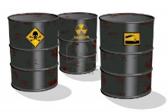

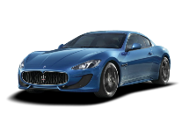


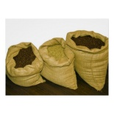


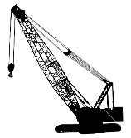



Also a matrix from hell
 | ? | ? | ? | ? | ? | ? | ?
 | ? | ? | ? | ? | ? | ? | ?
 | ? | ? | ? | ? | ? | ? | ?
 | ? | ? | ? | ? | ? | ? | ?
 | ? | ? | ? | ? | ? | ? | ?
 | ? | ? | ? | ? | ? | ? | ?

Slide 7

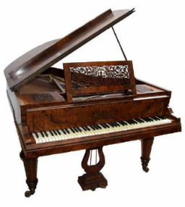

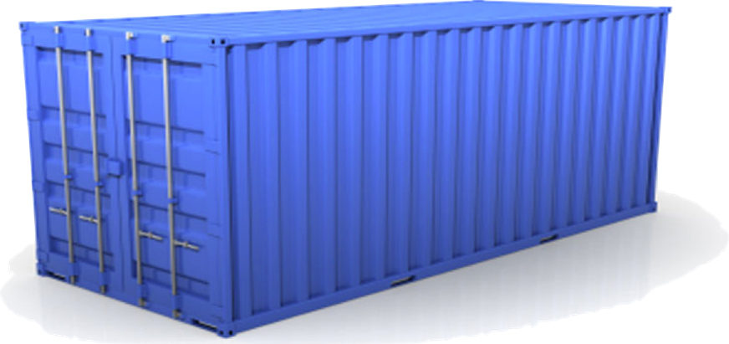
Solution: Intermodal Shipping Container
Do I worry about how goods interact (e.g. coffee beans next to spices)
Multiplicity of Goods
A standard container that is loaded with virtually any goods, and stays sealed until it reaches final delivery.
…in between, can be loaded and unloaded, stacked, transported efficiently over long distances, and transferred from one mode of transport to another
Can I transport quickly and smoothly
(e.g. from boat to train to truck)
Multiplicity of methods for transporting/storing

Slide 8
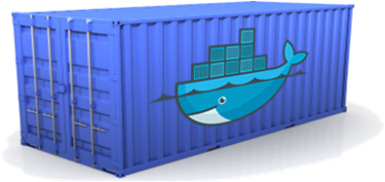
Docker is a shipping container system for code
Static website
User DB
Web frontend
Queue
Analytics DB
Do services and apps interact appropriately?
Multiplicity of Stacks
An engine that enables any payload to be encapsulated as a lightweight, portable, self-sufficient container…
…that can be manipulated using standard operations and run consistently on virtually any hardware platform
Multiplicity of hardware environments
Can I migrate smoothly and quickly
Development VM
QA server
Customer Data Center
Public Cloud
Production Cluster
Contributor’s laptop
Notes:
מאפשר שינוע של מוצרי תוכנה באופן סטנדרטי ונקי – הקונטיינר נותן למוצר את ה"צרכים" שלו – CPU, DISK וכו'.
Networking - עובר דרך NAT ומגדירים את המיפוי של הפורטים.

Slide 9
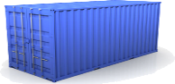
Docker eliminates the matrix from Hell
Static website
Web frontend
Background workers
User DB
Analytics DB
Queue
 | Development VM | QA Server | Single Prod Server | Onsite Cluster | Public Cloud | Contributor’s laptop | Customer Servers

Slide 10
Why Developers Care
Build once…(finally) run anywhere*
A clean, safe, hygienic and portable runtime environment for your app.
No worries about missing dependencies, packages and other pain points during subsequent deployments.
Run each app in its own isolated container, so you can run various versions of libraries and other dependencies for each app without worrying
Automate testing, integration, packaging…anything you can script
Reduce/eliminate concerns about compatibility on different platforms, either your own or your customers.
Cheap, zero-penalty containers to deploy services? A VM without the overhead of a VM? Instant replay and reset of image snapshots? That’s the power of Docker

Slide 11
Why Devops Cares?
Configure once…run anything
Make the entire lifecycle more efficient, consistent, and repeatable
Increase the quality of code produced by developers.
Eliminate inconsistencies between development, test, production, and customer environments
Support segregation of duties
Significantly improves the speed and reliability of continuous deployment and continuous integration systems
Because the containers are so lightweight, address significant performance, costs, deployment, and portability issues normally associated with VMs

Slide 12
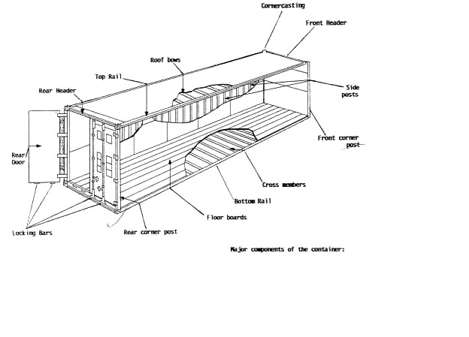
Why it works—separation of concerns
Dan the Developer
Worries about what’s “inside” the container
His code
His Libraries
His Package Manager
His Apps
His Data
All Linux servers look the same
Oscar the Ops Guy
Worries about what’s “outside” the container
Logging
Remote access
Monitoring
Network config
All containers start, stop, copy, attach, migrate, etc. the same way

Slide 13
More technical explanation
WHY
WHAT
Run everywhere
Regardless of kernel version (3.1.0+)
Regardless of host distro
Physical or virtual, cloud or not
Container and host architecture must match*
Run anything
If it can run on the host, it can run in the container
i.e. if it can run on a Linux kernel, it can run
High Level—It’s a lightweight VM
Own process space
Own network interface
Can run stuff as root
Can have its own /sbin/init (different from host)
<<machine container>>
Low Level—It’s chroot on steroids
Can also not have its own /sbin/init
Container=isolated processes
Share kernel with host
No device emulation (neither HVM nor PV) from host)
<<application container>>
Notes:
PV – power/para? virtualization

Slide 14
What is Docker, really?
• An Open-Source (Go) framework to manage “container virtualization”
• Docker isolates multiple user spaces (file systems) inside the same host
• The user space instances are called “Containers”
• They give you the illusion of being inside a different machine
• Think about “execution environments” or “sandboxes”
• No need for an hypervisor (and so very quick to launch)
• Requires x64 Linux and kernel 3.8+

Slide 15
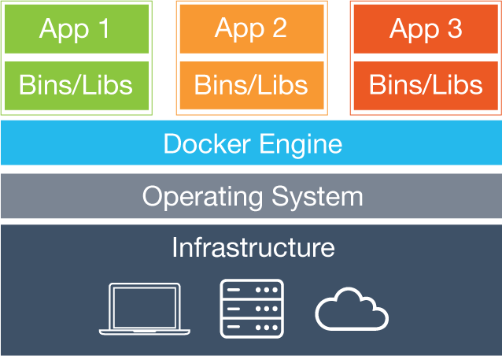
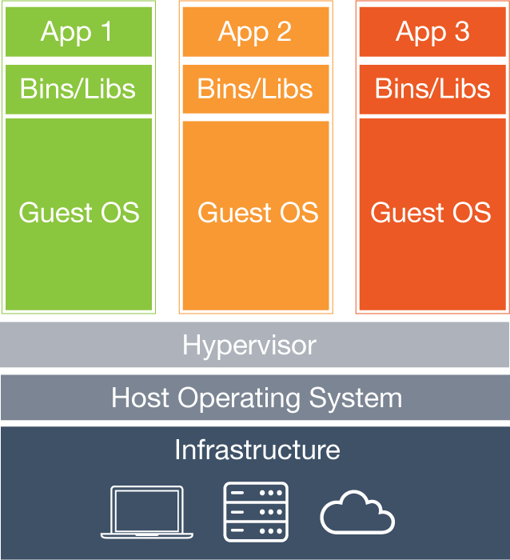
Containers vs virtual machines
Containers have similar resource isolation and allocation benefits as virtual machines
A different architectural approach allows them to be much more portable and efficient.
Virtual Machines
Each virtual machine includes the application, the necessary binaries and libraries and an entire guest operating system - all of which may be tens of GBs in size.
Containers
Containers include the application and all of its dependencies, but share the kernel with other containers. They run as an isolated process in userspace on the host operating system. They’re also not tied to any specific infrastructure – Docker containers run on any computer, on any infrastructure and in any cloud.
Source: https://www.docker.com/what-docker

Slide 16
Why are Docker containers lightweight?
VMs
Containers
App
A
App
A
App
A’
App
A
App
A
App Δ
Bins/
Libs
Bins/
Libs
Bins/
Libs
Bins/
Libs
Bins/
Guest
OS
Guest
OS
Guest
OS
Guest
OS
Original App
(No OS to take
up space, resources,
or require restart)
Copy of
App
No OS. Can
Share bins/libs
Modified App
Copy on write capabilities allow
us to only save the diffs
Between container A and container
A’
VMs
Every app, every copy of an
app, and every slight modification
of the app requires a new virtual server

Slide 17
What are the basics of the Docker system?
Docker
Container
Image Registry
Push
Container A
Search
Pull
Source Code Repository
Run
Build
Dockerfile
For
A
Container A
Container B
Container C
Docker
Docker Engine
Host 1 OS (Linux)
Host 2 OS (Linux)

Slide 18
Changes and Updates
Docker
Container
Image Registry
App
A
Push
App Δ
Bins/
Libs
Bins/
Base
Container
Image
Container Mod A’
Container Mod A’’
App Δ
Update
App
A’’
App
A
Bins/
Bins/
Libs
Bins/
Libs
Bins/
Docker Engine
Docker Engine
Host is now running A’’
Host running A wants to upgrade to A’’. Requests update. Gets only diffs

Slide 19
Who uses docker?
• Uber, eBay, BBC News, shopify, ING, Groupon, Orbitz
Lyft, Yandex, Spotify, New Relic, Gilt
• and many others…
• Used by Google Cloud (with the Container Engine + Kubernetes)
• Amazon (Amazon ECS)
Source: https://www.docker.com/customers

Slide 20
Who can benefit from Docker?
• Developers
• Yes, even mobile developers
• Sysadmins
• DevOps
• Architects/CTO/COO (want to save some money?)
• You (probably)

Slide 21
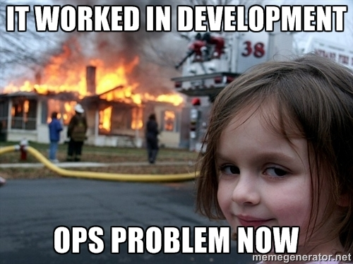
How does it help?
Creates a standard way to ship build artifacts
Ships the exact binary the developer had

Slide 22
Microservices overview

Slide 23


Slide 24
Micro-service architecture benefits
Eliminates dependencies
Failure is isolated
React to change quicker
Scale is less expensive (APIs scale individually)
More intuitive learning curve
Technology stack is not limited to specific skillsets
Reusable components
Flexible – will bend rather than break under pressure

Slide 25


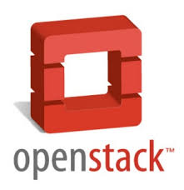






Ecosystem Support
Operating systems
Virtually any distribution with a 2.6.32+ kernel
Red Hat/Docker collaboration to make work across RHEL 6.4+, Fedora, and other members of the family (2.6.32 +)
CoreOS—Small core OS purpose built with Docker
OpenStack
Docker integration into NOVA (& compatibility with Glance, Horizon, etc.) accepted for Havana release
Private PaaS
OpenShift
Solum (Rackspace, OpenStack)
Other TBA
Public PaaS
Deis, Voxoz, Cocaine (Yandex), Baidu PaaS
Public IaaS
Native support in Rackspace, Digital Ocean,+++
AMI (or equivalent) available for AWS & other
DevOps Tools
Integrations with Chef, Puppet, Jenkins, Travis, Salt, Ansible +++
Orchestration tools
Mesos, Heat, ++
Shipyard & others purpose built for Docker
Applications
1000’s of Dockerized applications available at index.docker.io

Slide 26
Use Cases
Ted Dziuba on the Use of Docker for Continuous Integration at Ebay Now
https://speakerdeck.com/teddziuba/docker-at-ebay
http://www.youtube.com/watch?feature=player_embedded&v=0Hi0W4gX--4
Sasha Klizhentas on use of Docker at Mailgun/Rackspace
http://www.youtube.com/watch?feature=player_embedded&v=CMC3xdAo9RI
Sebastien Pahl on use of Docker at CloudFlare
http://www.youtube.com/watch?feature=player_embedded&v=-Lj3jt_-3r0
Cambridge HealthCare
http://blog.howareyou.com/post/62157486858/continuous-delivery-with-docker-and-jenkins-part-i
Red Hat Openshift and Docker
https://www.openshift.com/blogs/technical-thoughts-on-openshift-and-docker

Slide 27
Use Cases—From Our Community
Use Case | Examples | Link
Clusters | Building a MongoDB cluster using docker | http://bit.ly/1acbjZf
 | Production Quality MongoDB Setup with Docker | http://bit.ly/15CaiHb
 | http://bit.ly/1bClX0O
Build your own PaaS | OpenSource PaaS built on Docker, Chef, and Heroku Buildpacks | http://deis.io
Web Based Environment for Instruction | JiffyLab – web based environment for the instruction, or lightweight use of, Python and UNIX shell | http://bit.ly/12oaj2K
Easy Application Deployment | Deploy Java Apps With Docker = Awesome | http://bit.ly/11BCvvu
 | http://bit.ly/1b4XtJ3
 | http://bit.ly/15MJS6B
 | http://bit.ly/16EWOKh
Create Secure Sandboxes | Docker makes creating secure sandboxes easier than ever | http://bit.ly/13mZGJH
Create your own SaaS | Memcached as a Service | http://bit.ly/11nL8vh
Automated Application Deployment | Multi-cloud Deployment with Docker | http://bit.ly/1bF3CN6
Continuous Integration and Deployment | Next Generation Continuous Integration & Deployment with dotCloud’s Docker and Strider | http://bit.ly/ZwTfoy
 | http://bit.ly/1eFBtcm
Lightweight Desktop Virtualization | Docker Desktop: Your Desktop Over SSH Running Inside Of A Docker Container | http://bit.ly/14RYL6x

Slide 28
Lets get started!

Slide 29
Docker Terminology
• Docker, aka Docker Engine: the daemon managing docker images and containers (using namespaces and cgroups). It runs on the (Linux-based) Host.
• Docker client: the binary interacting with the Docker Engine.
• Docker Image: a filesystem (read-only template) used to create a Container (think “the binary”)
• Docker Container: a running image providing a service (think “the process”)
• Host: the computer running the Docker Engine
• Docker Registry: a private or public (Docker Hub) collection of Docker Images
• Docker Machine: provision hosts and install Docker on them
Notes:
https://get.docker.com
התקנת ה-docker engine (אנחנו משתמשים בקורס ב-AWS).
הוספנו הרשאות של student לקבוצה docker - נותן גישה ל-socket של docker (/run/docker.sock)
התחברות דרך - ssh 34.248.220.168 -l student(user/pass - student)
https://hub.docker.com

Slide 30
Obtaining and installing Docker
First we need to install the docker daemon and client binaries
Run “curl -fsSL https://get.docker.com/ | sh”
This script will ask you for your sudo password and install all the required binaries
Now lets verify that our installation is complete
Run “docker run hello-world”
If the above command fails, you may need to add your
user to the docker group before docker will run
“sudo usermod -a -G docker YOURUSERNAME”
For complete instructions and other Operating systems:
https://docs.docker.com/linux/

Slide 31
If everything is worked properly you should see the following message:
Hello from Docker.
This message shows that your installation appears to be working correctly.
To generate this message, Docker took the following steps:
1. The Docker Engine CLI client contacted the Docker Engine daemon.
2. The Docker Engine daemon pulled the "hello-world" image from the Docker Hub.
3. The Docker Engine daemon created a new container from that image which runs the
executable that produces the output you are currently reading.
4. The Docker Engine daemon streamed that output to the Docker Engine CLI client,
which sent it to your terminal.

Slide 32
Docker Architecture
Docker utilizes several feature of the Linux kernel to function
Cgroups (What you can do)
Namespaces (What you have)
Union file systems
Notes:
Cgroups -
n/s – system what can we see

Slide 33
Cgroups
cgroups is a Linux kernel feature that limits, accounts for, and isolates the resource usage (CPU, memory, disk I/O, network, etc.) of a collection of processes.
This allows us for manage the following per container
Memory
Cpu time
Network bandwidth
Disk bandwidth

Slide 34
Cgroup features
Resource limitation: groups can be set to not exceed a configured memory limit, which also includes the file system cache
Prioritization: some groups may get a larger share of CPU utilization[8] or disk I/O throughput
Accounting: measures how much resources certain systems use, which may be used, for example, for billing purposes
Control: freezing the groups of processes, their checkpointing and restarting

Slide 35
Namespaces
This provides a layer of isolation: each aspect of a container runs in its own namespace and does not have access outside it
The pid namespace: Used for process isolation (PID: Process ID).
The net namespace: Used for managing network interfaces (NET: Networking).
The ipc namespace: Used for managing access to IPC resources (IPC: InterProcess Communication).
The mnt namespace: Used for managing mount-points (MNT: Mount).
The uts namespace: Used for isolating kernel and version identifiers. (UTS: Unix Timesharing System).

Slide 36
Union File systems
Union file systems, or UnionFS, are file systems that operate by creating layers
Docker uses union file systems to provide the building blocks for containers
Docker can make use of several union file system variants including: AUFS, btrfs, vfs, and DeviceMapper.
The most popular is AUFS

Slide 37
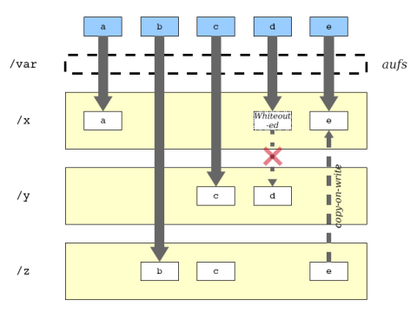
AUFS layers

Slide 38
Connecting everything
Docker is the combination of these components
LXC → LinuX Container = namespaces + cgroups
AUFS

Slide 39
Lets get our hands dirty!

Slide 40
Exercise 1 - Our first docker container
Download from the registry
Execute command inside container Interactive with container
$ docker search ubuntu # from lots of release
$ docker pull ubuntu:latest # may take minutes
Pulling repository ubuntu
ad892dd21d60: Pulling dependent layers
511136ea3c5a: Pulling fs layer
$ docker images # list local images
REPOSITORY TAG IMAGE ID CREATED VIRTUAL SIZE
ubuntu latest ad892dd21d60 6 days ago 275.5 MB
$ docker run ubuntu echo “Hello World”
$ docker run -i -t ubuntu bash

Slide 41
docker - the command line tool
Some common commands:
$ docker search # search hub.docker.com for an image
$ docker pull # download image
$ docker images # list all existing local images
$ docker run # initiates a container from an image
$ docker ps # list running containers
$ docker build # build images from Dockerfile
$ docker start/stop/kill # commands
$ docker rm/rmi to remove a container or image

Slide 42
Exercise 2 - Add own package and image
Try to install apache2 inside
$ docker run -i -t ubuntu /bin/bash
# apt-get update && apt-get install –y apache2
# exit
$ docker ps –l # -l means –latest
CONTAINER ID IMAGE COMMAND CREATED STATUS
c4bd63cc87f1 ubuntu:latest bash 2 minutes ago Exited 2 sec
$ docker commit <container id> apache2
66db661d9ad8681b082bb62b21b6ef5f2ddb4799e3df5dbd8fb23aed16616b1d
Check and run it again to see the apache is there
$ docker images
REPOSITORY TAG IMAGE ID CREATED VIRTUAL SIZE
apache2 latest 66db661d9ad8 28 seconds ago 298.5 MB
ubuntu latest ad892dd21d60 6 days ago 275.5 MB
$ docker run –i –t apache2 bash # check apache

Slide 43
How does this work?
Docker images are saved in layers
$ docker images –tree
Warning: '--tree' is deprecated, it will be removed soon. See usage.
└─511136ea3c5a Virtual Size: 0 B
└─e465fff03bce Virtual Size: 192.5 MB
└─23f361102fae Virtual Size: 192.7 MB
└─9db365ecbcbb Virtual Size: 192.7 MB
└─ad892dd21d60 Virtual Size: 275.5 MB Tags: ubuntu:latest
└─66db661d9ad8 Virtual Size: 298.5 MB Tags: apache2:latest

Slide 44
When Docker mounts the rootfs, it starts read-only
Uses aufs) to add a read-write file system over the read-only file system
There are multiple read-only file systems stacked on top of each other
each one of these file systems is a layer.

Slide 45
Exercise 3 Understanding the layers
Data are stored under /var/lib/docker (root permission)
$ ls –al /var/lib/docker
$ ls -1 /var/lib/docker/aufs/diff/
..
66db661d9ad8681b082bb62b21b6ef5f2ddb4799e3df5dbd8fb23aed16616b1d/
9db365ecbcbbb20e063eac70842c53e27fcad0e213f9d4ddb78152339cedd3b1/
See what is diff inside /var/lib/docker/aufs/diff/<image id>
$ find /var/lib/docker/aufs/diff/66* | grep apache2

Slide 46
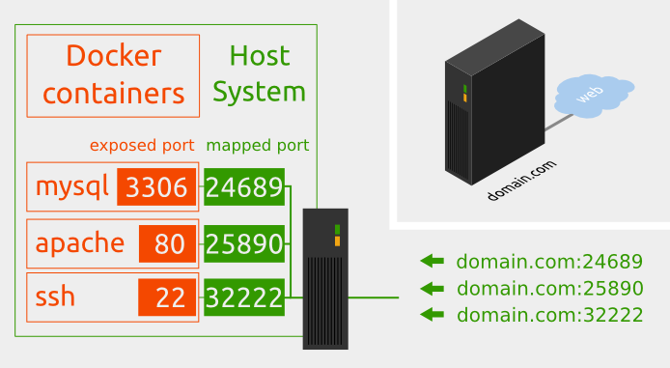
Networking in docker
By default the network in the container is not visible outside – everything is NATed
The services can be exposed by Port
Run –p host:guest # assign port to host
$ docker run –p 25890:80 –i –t apache2 bash
# apache2ctl start

Slide 47
Docker Daemon mode
Interactive mode vs. Daemon (Deattach) mode (docker run)
-d : run in daemon mode -i : run in interactive mode (CTRL-P-Q to quit from shell to enter daemon mode, exit will stop the container) $ docker attach <container ID> : connect to existing container
Other parameters for docker run
--name : define container name
Enter into existing docker container (since 1.3 version) $ docker exec -it <container ID> bash

Slide 48
Exercise 4: Expose the service
Export the port to host as 25890 and start the service manually
$ docker run -p 25890:80 –i -t apache2 bash
root@35ac981a49e5:/# service apache2 start
$ docker ps # in another shell
CONTAINER ID IMAGE …. STATUS PORTS NAMES e020aa2c02a5 apache2:latest ….. Up 14 seconds 0.0.0.0:25890->80/tcp web
$ curl http://localhost:25890
Come into the container again to check
$ docker exec –it e020aa2c02a5 bash
Run contain in daemon mode
$ docker run –p 25891:80 –d –t apache2 apache2ctl –D FOREGROUND

Slide 49
Dockerfile
Dockerfiles = image representations
Simple syntax for building images
Automate and script the images creation

Slide 50
Dockerfile
Dockerfile Syntax
FROM – defines base image
RUN - executes arbitrary command ENV – sets environment
EXPOSE – expose a port
ADD – add local file
CMD – default command to execute
MAINTAINER – author information
Used by docker build
Notes:
docker build מאפשר לבנות image חדש.

Slide 51
FROM
Sets the base image for subsequent instructions
Usage: FROM <image>
Example: FROM ubuntu
Needs to be the first instruction of every Dockerfile
TIP: find images with the command: docker search

Slide 52
RUN
Executes any commands on the current image and commit the results
Usage: RUN <command>
Example: RUN apt-get install –y memcached
FROM ubuntu
RUN apt-get install -y memcached
Is equivalent to:
docker run ubuntu apt-get install -y memcached
docker commit XXX

Slide 53
docker build
Creates an image from a Dockerfile
From the current directory = docker build
From stdin = docker build - < Dockerfile
From GitHub = docker build github.com/creack/docker-firefox
TIP: Use –t to tag your image

Slide 54
Example: Memcached
FROM ubuntu
RUN echo "deb http://archive.ubuntu.com/ubuntu precise main universe" > /etc/apt/sources.list
RUN apt-get update
RUN apt-get install -y memcached
Docker build –t memcached .

Slide 55
# Commenting
# Memcached
#
# VERSION 1.0
# use the ubuntu base image provided by dotCloud
FROM ubuntu
# make sure the package repository is up to date
RUN echo "deb http://archive.ubuntu.com/ubuntu precise main universe" > /etc/apt/sources.list
RUN apt-get update
# install memcached
RUN apt-get install -y memcached

Slide 56
ENTRYPOINT
Triggers a command as soon as the container starts
Example: ENTRYPOINT echo “Whale You Be My Container?”
#
# VERSION 0.1.2
# use the ubuntu base image
FROM ubuntu
# say hello when the container is launched
ENTRYPOINT echo "Hello ubuntu"

Slide 57
ENTRYPOINT option 2
Run containers as executables! :)
cat /etc/passwd | docker run -i wc
# This is wc
#
# VERSION 0.42
# use the base image provided by dotCloud
FROM base
MAINTAINER Victor Coisne victor.coisne@dotcloud.com
# count lines with wc
ENTRYPOINT ["wc", "-l"]

Slide 58
USER
Sets the username to use when running the image
Needs to exist in host machine
Example: USER daemon

Slide 59
EXPOSE
Sets ports to be publicly exposed when running the image
Example: EXPOSE 11211
Will expose internal port to identical external (on host machine) port

Slide 60
Exercise 5: Dockerfile apache2/wget
Write the Dockerfile
$ mkdir /tmp/docker ; vi /tmp/docker/Dockerfile
$ cd /tmp/docker
$ docker build –t wget .
$ docker images --tree
Start the wget image and verify
FROM apache2
RUN apt-get install -y wget

Slide 61
Share images in docker repository
Docker is also a tool for sharing. A repository is a shareable collection of tagged images that together create the file systems for containers.
Public repo. <username>/<repo_name>
$ docker search/pull/login/push

Slide 62
Exercise 6: Share your image
Register in https://hub.docker.com/
Tag the wget image
$ docker tag wget omrisiri/wget:latest
Docker push omrisiri/wget

Slide 63
Docker best practices

Slide 64
Containers should be ephemeral
The container produced by the image your Dockerfile defines should be as ephemeral as possible
By “ephemeral,” we mean that it can be stopped and destroyed and a new one built and put in place with an absolute minimum of set-up and configuration.

Slide 65
Use a .dockerignore file
In most cases, it’s best to put each Dockerfile in an empty directory.
Then, add to that directory only the files needed for building the Dockerfile
To increase the build’s performance, exclude files and directories by adding a .dockerignore file to that directory as well.

Slide 66
Here is an example .dockerignore file:
*/temp*
*/*/temp*
temp?
*.md
!README.md
Rule | Behavior
*/temp* | Exclude files and directories whose names start with temp in any immediate subdirectory of the root. For example, the plain file /somedir/temporary.txt is excluded, as is the directory /somedir/temp.
*/*/temp* | Exclude files and directories starting with temp from any subdirectory that is two levels below the root. For example, /somedir/subdir/temporary.txt is excluded.
temp? | Exclude files and directories in the root directory whose names are a one-character extension of temp. For example, /tempa and /tempb are excluded.
!README*.md | Lines starting with ! (exclamation mark) can be used to make exceptions to exclusions

Slide 67
Avoid installing unnecessary packages
In order to reduce complexity, dependencies, file sizes, and build times, you should avoid installing extra or unnecessary packages
For example, you don’t need to include a text editor in a database image.

Slide 68
Run only one process per container
In almost all cases, you should only run a single process in a single container.
Decoupling applications into multiple containers makes it much easier to scale horizontally and reuse containers
If that service depends on another service, make use of container linking.

Slide 69
Sort multi-line arguments
Whenever possible, ease later changes by sorting multi-line arguments alphanumerically.
RUN apt-get update && apt-get install -y \
bzr \
cvs \
git \
mercurial \
subversion

Slide 70
Build cache
During the process of building an image Docker will step through the instructions in your Dockerfile executing each in the order specified.
As each instruction is examined Docker will look for an existing image in its cache that it can reuse
If you do not want to use the cache at all you can use the --no-cache=true option on the docker build command.
The next slides explain a bit more about build cache

Slide 71
Build cache
It’s important to understand when it will and will not find an image in the cache
These are the basic rules:
Starting with a base image that is already in the cache, the next instruction is compared against all child images derived from that base image to see if one of them was built using the exact same instruction. If not, the cache is invalidated.
For the ADD and COPY instructions, the contents of the file(s) in the image are examined and a checksum is calculated for each file. The last-modified and last-accessed times of the file(s) are not considered in these checksums. During the cache lookup, the checksum is compared against the checksum in the existing images. If anything has changed in the file(s), such as the contents and metadata, then the cache is invalidated.
Aside from the ADD and COPY commands, cache checking will not look at the files in the container to determine a cache match. For example, when processing a RUN apt-get -y update command the files updated in the container will not be examined to determine if a cache hit exists. In that case just the command string itself will be used to find a match.
Once the cache is invalidated, all subsequent Dockerfile commands will generate new images and the cache will not be used.

Slide 72
The Dockerfile instructions – Best practices
FROM
Whenever possible, use current Official Repositories as the basis for your image. We recommend the Debian or ubuntu image since it’s very tightly controlled and kept minimal (currently under 150 mb), while still being a full distribution.
RUN
As always, to make your Dockerfile more readable, understandable, and maintainable, split long or complex RUN statements on multiple lines separated with backslashes.
Apt-get
Probably the most common use-case for RUN is an application of apt-get. The RUN apt-get command, because it installs packages, has several gotchas to look out for.
You should avoid RUN apt-get upgrade or dist-upgrade
If you know there’s a particular package, foo, that needs to be updated, use apt-get install -y foo
Always combine RUN apt-get update with apt-get install in the same RUN statement
Using apt-get update alone in a RUN statement causes caching issues and subsequent apt-get install instructions fail → If you run apt-get update as separate statements it will be cached and you will get old and outdated version

Slide 73
The Dockerfile instructions – Best practices
CMD
The CMD instruction should be used to run the software contained by your image, along with any arguments.
CMD should almost always be used in the form of CMD [“executable”, “param1”, “param2”…]
EXPOSE
The EXPOSE instruction indicates the ports on which a container will listen for connections.
Consequently, you should use the common, traditional port for your application
ENV
order to make new software easier to run, you can use ENV to update the PATH environment variable for the software your container installs.
For example, ENV PATH /usr/local/nginx/bin:$PATH will ensure that CMD [“nginx”] just works
The ENV instruction is also useful for providing required environment variables specific to services you wish to containerize, such as Postgres’s PGDATA..
Lastly, ENV can also be used to set commonly used version numbers so that version bumps are easier to maintain, as seen in the following example:
ENV PG_MAJOR 9.3
ENV PG_VERSION 9.3.4
RUN curl -SL http://example.com/postgres-$PG_VERSION.tar.xz | tar -xJC /usr/src/postgress && …
ENV PATH /usr/local/postgres-$PG_MAJOR/bin:$PATH

Slide 74
The Dockerfile instructions – Best practices
ADD or COPY
Although ADD and COPY are functionally similar, COPY is preferred.
it’s more transparent than ADD
COPY only supports the basic copying of local files into the container, while ADD has some features (like local-only tar extraction and remote URL support) that are not immediately obvious.
If you have multiple Dockerfile steps that use different files, COPY them individually, rather than all at once.
This will ensure that each step’s build cache is only invalidated on change
ENTRYPOINT
The best use for ENTRYPOINT is to set the image’s main command, allowing that image to be run as though it was that command (and then use CMD as the default flags)
Example:
ENTRYPOINT ["s3cmd"] CMD ["--help"]
Now we can run : docker run s3cmd ls s3://mybucket

Slide 75
The Dockerfile instructions – Best practices
VOLUME
The VOLUME instruction should be used to expose any database storage area, configuration storage or files/folders created by your docker container
You are strongly encouraged to use VOLUME for any mutable and/or user-serviceable parts of your image.
USER
If a service can run without privileges, use USER to change to a non-root user
Start by creating the user and group in the Dockerfile with something like:
RUN groupadd -r postgres && useradd -r -g postgres postgres
You should avoid installing or using sudo since it has unpredictable TTY and signal-forwarding behavior that can cause more problems than it solves
WORKDIR
For clarity and reliability, you should always use absolute paths for your WORKDIR
use WORKDIR instead of proliferating instructions like RUN cd … && do-something, which are hard to read, troubleshoot, and maintain.

Slide 76
Want to learn more?
www.docker.io:
Documentation
Getting started: interactive tutorial, installation instructions, getting started guide,
About: Introductory whitepaper: http://www.docker.io/the-whole-story/
Github: dotcloud/docker
IRC: freenode/#docker
Google groups: groups.google.com/forum/#!forum/docker-user
Twitter: follow @docker
Meetups: Scheduled for Boston, San Francisco, Austin, London, Paris, Boulder…and Nairobi. https://www.docker.io/meetups/

Slide 77
www.docker.io

